Slide 1
SOFTWARE IMPLEMENTATION

Slide 2

Factors for coding
(Practical Considerations, Standards & Guidelines)

Slide 3

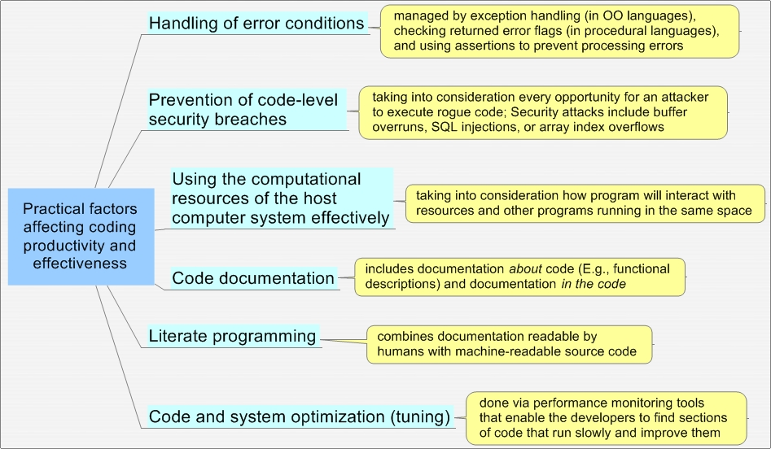
Practical Considerations for effective Coding

Slide 4
Coding Standards & Guidelines Generics
Standards are rules which are mandatory to be followed while guidelines are recommended to be followed.
Significant literature use these two terminologies interchangeably
There are rules which can be standards and guidelines.
These can be practiced as checklists and enforced as part of reviews
These could be specific for a language, company or a group
Some examples of Standards and Guidelines
Standard headers for different modules
Naming Conventions for local and global variables and for constant identifiers should be as ….
One declaration per line.
Avoid magic numbers.

Slide 5
Coding Standards – Mandatory to be followed
A coding standard provides a uniform appearance to the codes written by different engineers
Using coding standards, improves readability, maintainability and reduces complexity too
Some of the coding practices are part of coding standards like
Defensive programming
Secure programming
Testable programming
Thus some of the commonly occurring issues with code can be proactively addressed e.g. by having a standard like All “function/method return values” have to be handled will enable gracious handling.
It helps in code reuse
It promotes sound programming practices and increases efficiency of the programmers.

Slide 6
Coding Standards – Mandatory to be followed - Illustrations
Rules for usage of global about which type of data
Standard headers for different modules containing
Name of the module
Date of module creation
Author of the module
Modification history
Synopsis of the module about what the module does
Different functions supported in the module along with their input output parameters
Global variables accessed or modified by the module
Naming convention for variables – one type of naming for local variables and one for global data
Error return values and exception handling conventions like return 0 or -1
…………………

Slide 7
Coding Standard Practices : Defensive Programming
Murphy's Law - If anything can go wrong, it will.
• Redundant code is incorporated to check system state after
modifications
• Implicit assumptions are tested explicitly
pid = fork ();
if (pid == 0)
{
/* child process … do your stuff */
}
else if (pid < 0)
/* The fork failed. Report failure. */
else
/* This is the parent process.. do your stuff */
..

Slide 8
Coding Standard Practices : Secure Programming
Secure coding is the practice of developing computer software in a way that guards against the accidental introduction of security vulnerabilities
Defects, bugs and logic flaws are consistently the primary cause of commonly exploited software vulnerabilities. Some of the approaches or practices which can avoid these are
Validate input. Validate input from all untrusted data sources.
Heed compiler warnings. Compile code using the highest warning level available for your compiler and eliminate warnings by modifying the code. Use static and dynamic analysis tools to detect and eliminate additional security flaws.
Default deny. Access decisions are based on permission rather than exclusion or by default, access is denied & identified ones are permitted.

Slide 9
Coding Standard Practices : Secure Programming
Adhere to the principle of least privilege. Every process should execute with the least set of privileges necessary to complete the job. Elevated permission should only be accessed for the least amount of time required to complete the privileged task.
Sanitize data sent to other systems. Sanitize all data passed to complex subsystems such as command shells, relational databases, and commercial off-the-shelf (COTS) components.

Slide 10
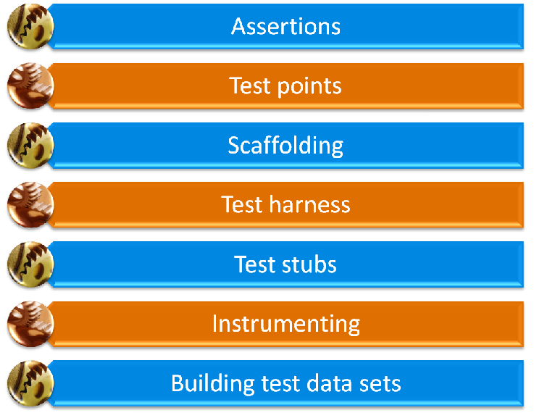
Coding Standard Practices : Programming for Testability
We need to construct software to make it easy to test … and find and fix bugs
methods that can be used to set or retrieve current module status and variable contents
Use assertions to identify out-of-range or inappropriate values
whenever possible
code written to drive objects, modules, or
components as if they were part of the complete system
code written to emulate a feature of the system that the object would call or send a message to
code that returns known fixed values that emulate
functions not currently under test
execution logging and “I got here” messages to know what’s going on inside modules
… includes testing both valid and invalid data

Slide 11
Coding Guidelines – Recommended to be followed
Like coding standards, coding guidelines also gives a uniform appearance to the codes written by different engineers
Most of these are guidelines are generic suggestions regarding the coding style that need to be followed for betterment of understanding, readability of the code.
Helps in detecting errors in the early phases, thus reducing the extra cost incurred by the software project.
Increases readability and understandability thus it reduces the complexity of the code.
It makes it simpler for others & helps towards maintenance over the lifetime of the product. Eg.
Code should be well documented
Indent code with spaces and lines
Keep the length of the functions small
Minimize using GOTO statements
Avoid using identifiers for multiple purposes
…………………

